Slide 1
Automatic Mosaics
Jacob Oakes and Lance Riechel

Slide 2
Initial Approaches
Match by Correlation
Match by Monogenic Phase

Slide 3
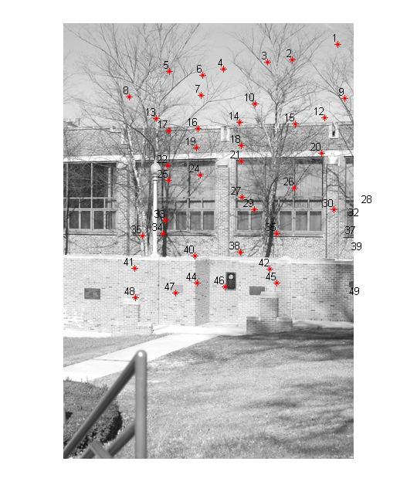
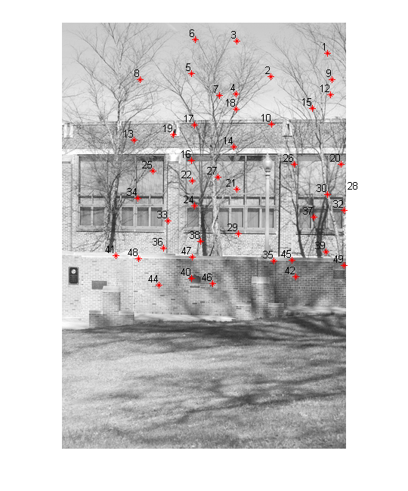
Match by Correlation

Slide 4
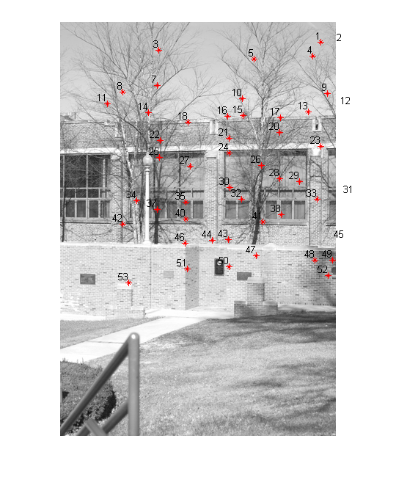
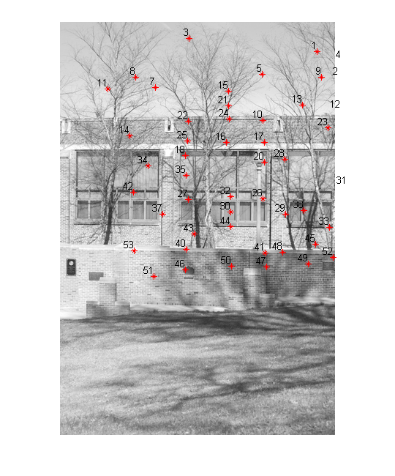
Match by Monogenic Phase

Slide 5
Things that worked
Match by template
RANSAC

Slide 6
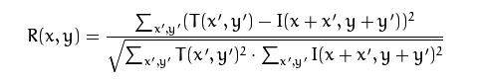
Template Matching
Used Harris corner detection to get features
Dynamically tweaked parameters to consider for this depending on how many points found.
Subtracted of the mean brightness of both images.
All done in grayscale for simplicity

Slide 7
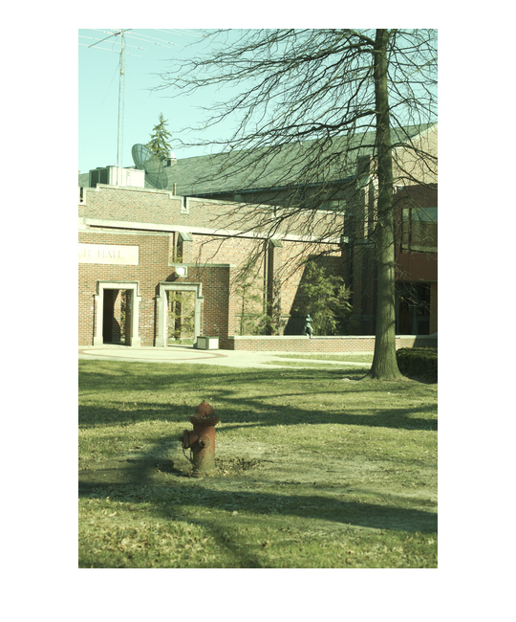
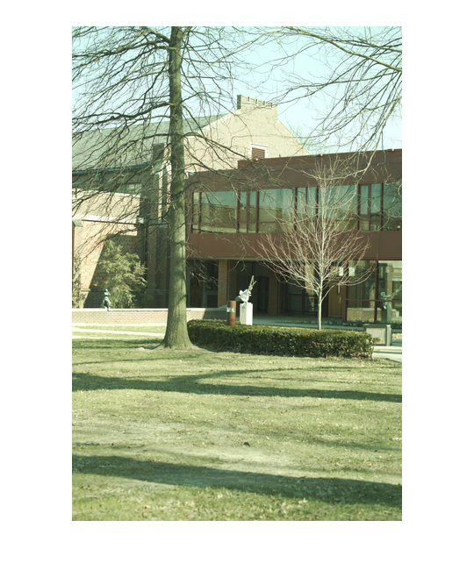
Difference in Brightness

Slide 8
Improvements
Removing duplicates
Removing by distance

Slide 9
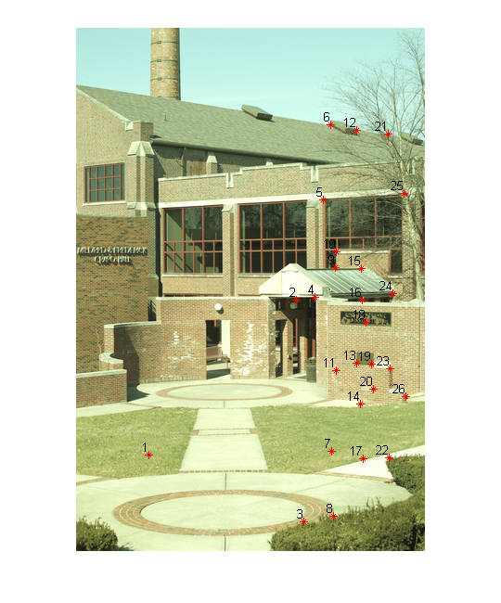
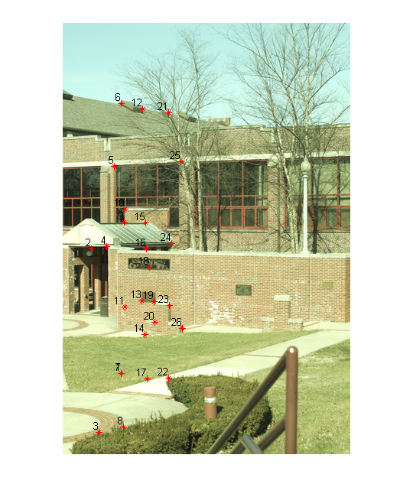
Duplicates

Slide 10
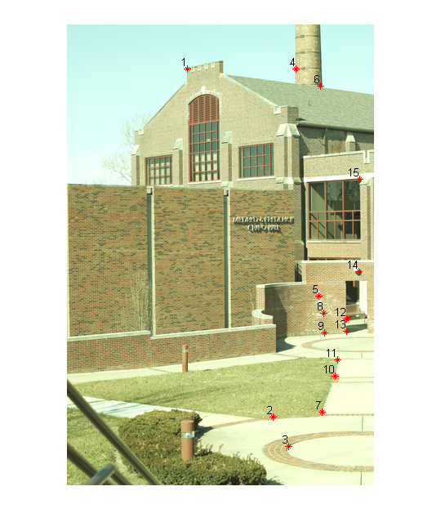
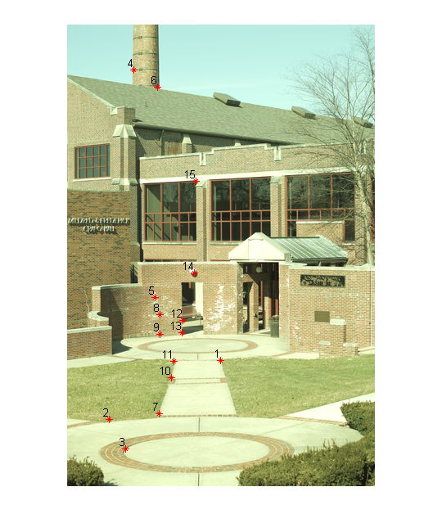
Distance

Slide 11
Final Approach
Match by template
Remove duplicates
RANSAC
Remove by distance

Slide 12
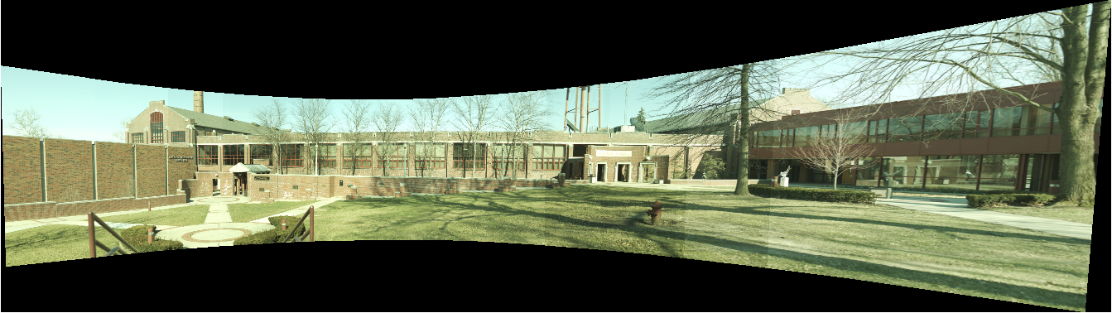
Results

Slide 13
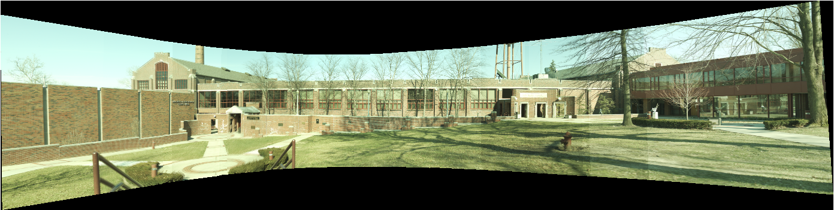
With Matching Points from PS3

Slide 14
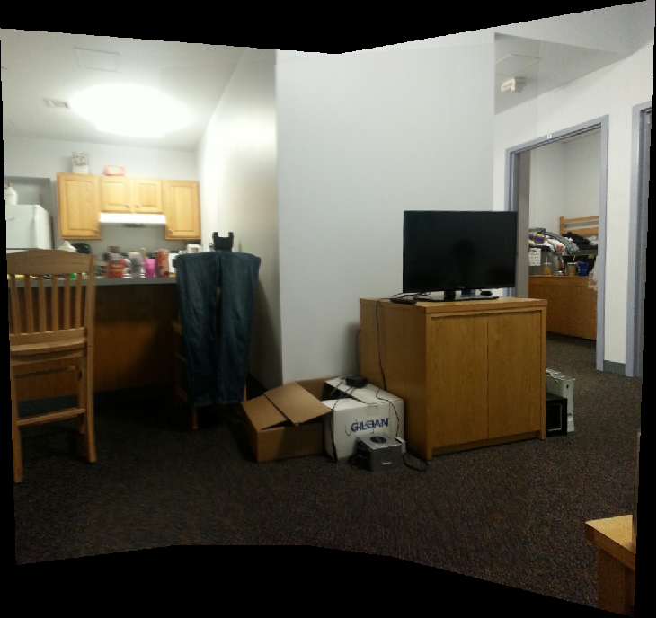
Other Results

Slide 15
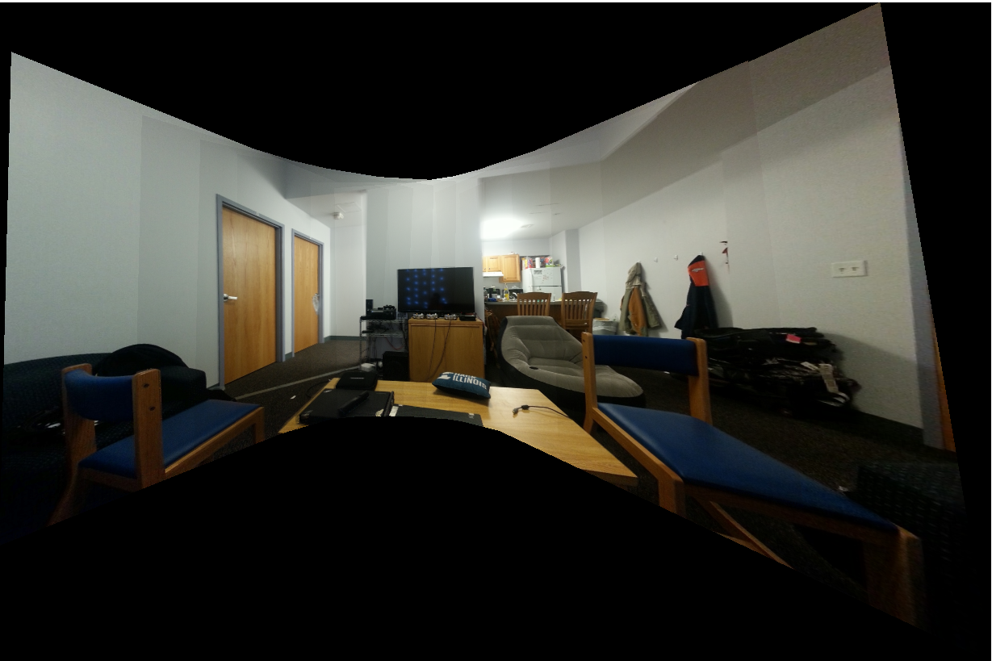
Other Results

Slide 16
Questions

